Slide 1

Thermal Mass Storage Weekly Meeting
February 16, 2024

Slide 2

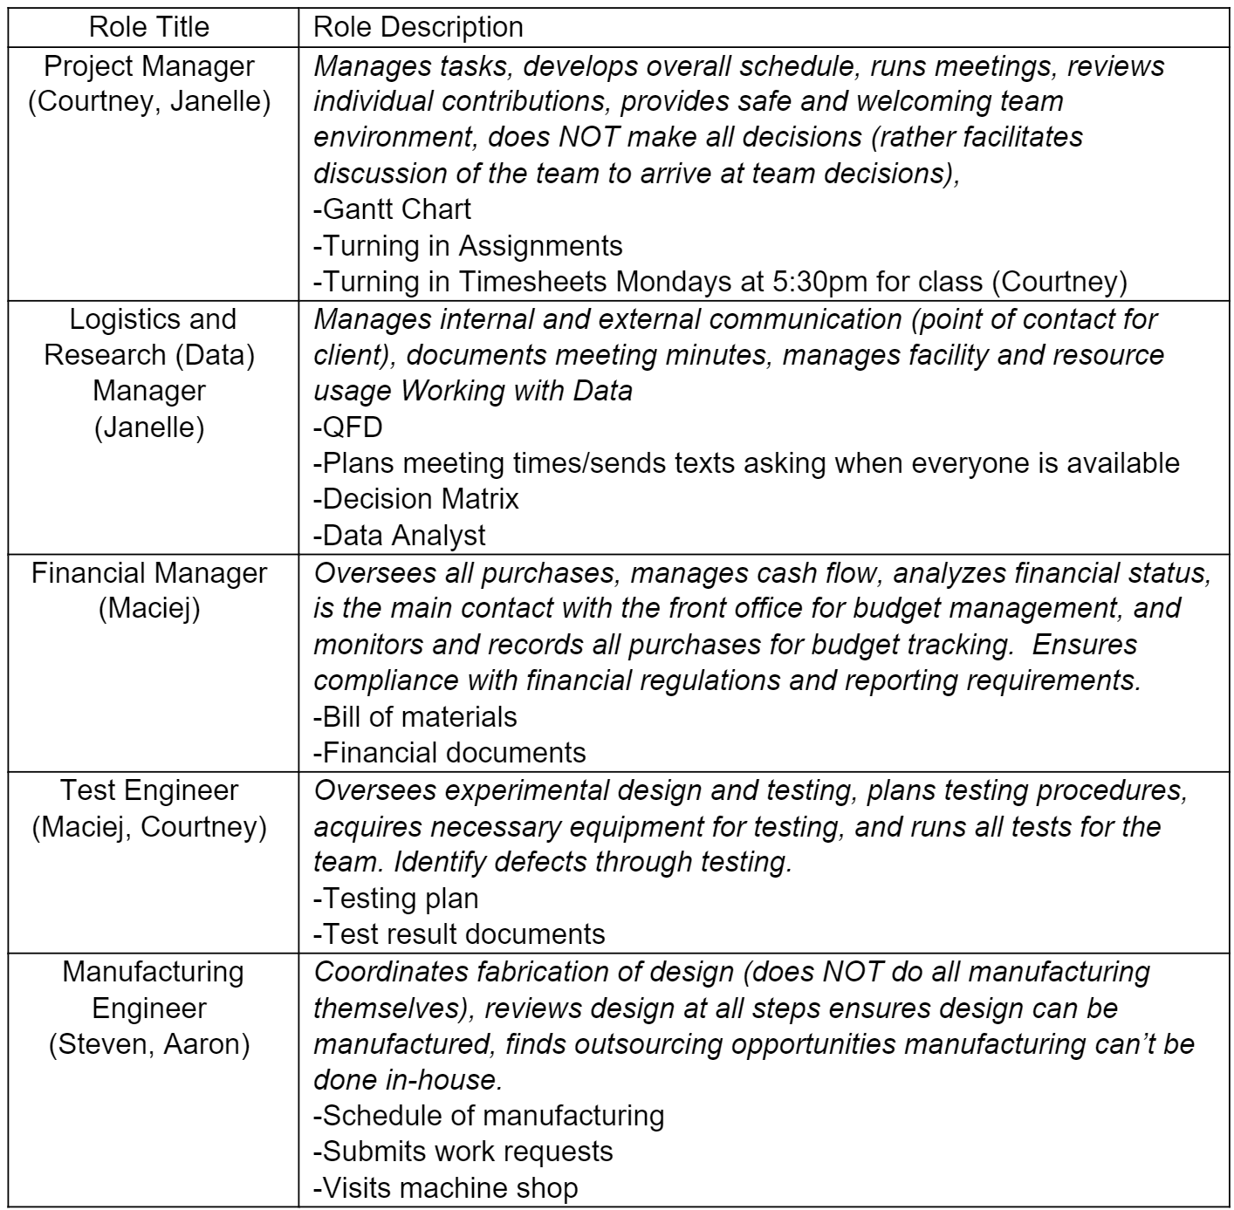

Roles

Slide 3
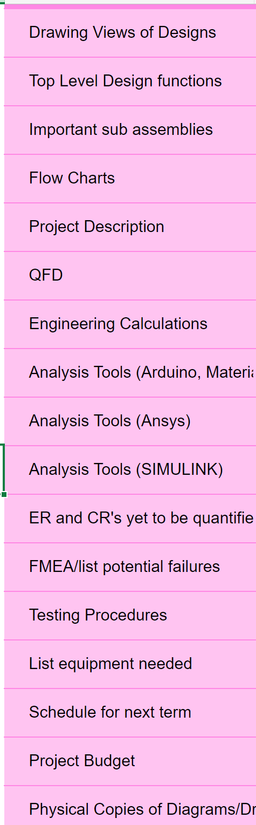

Slide 4
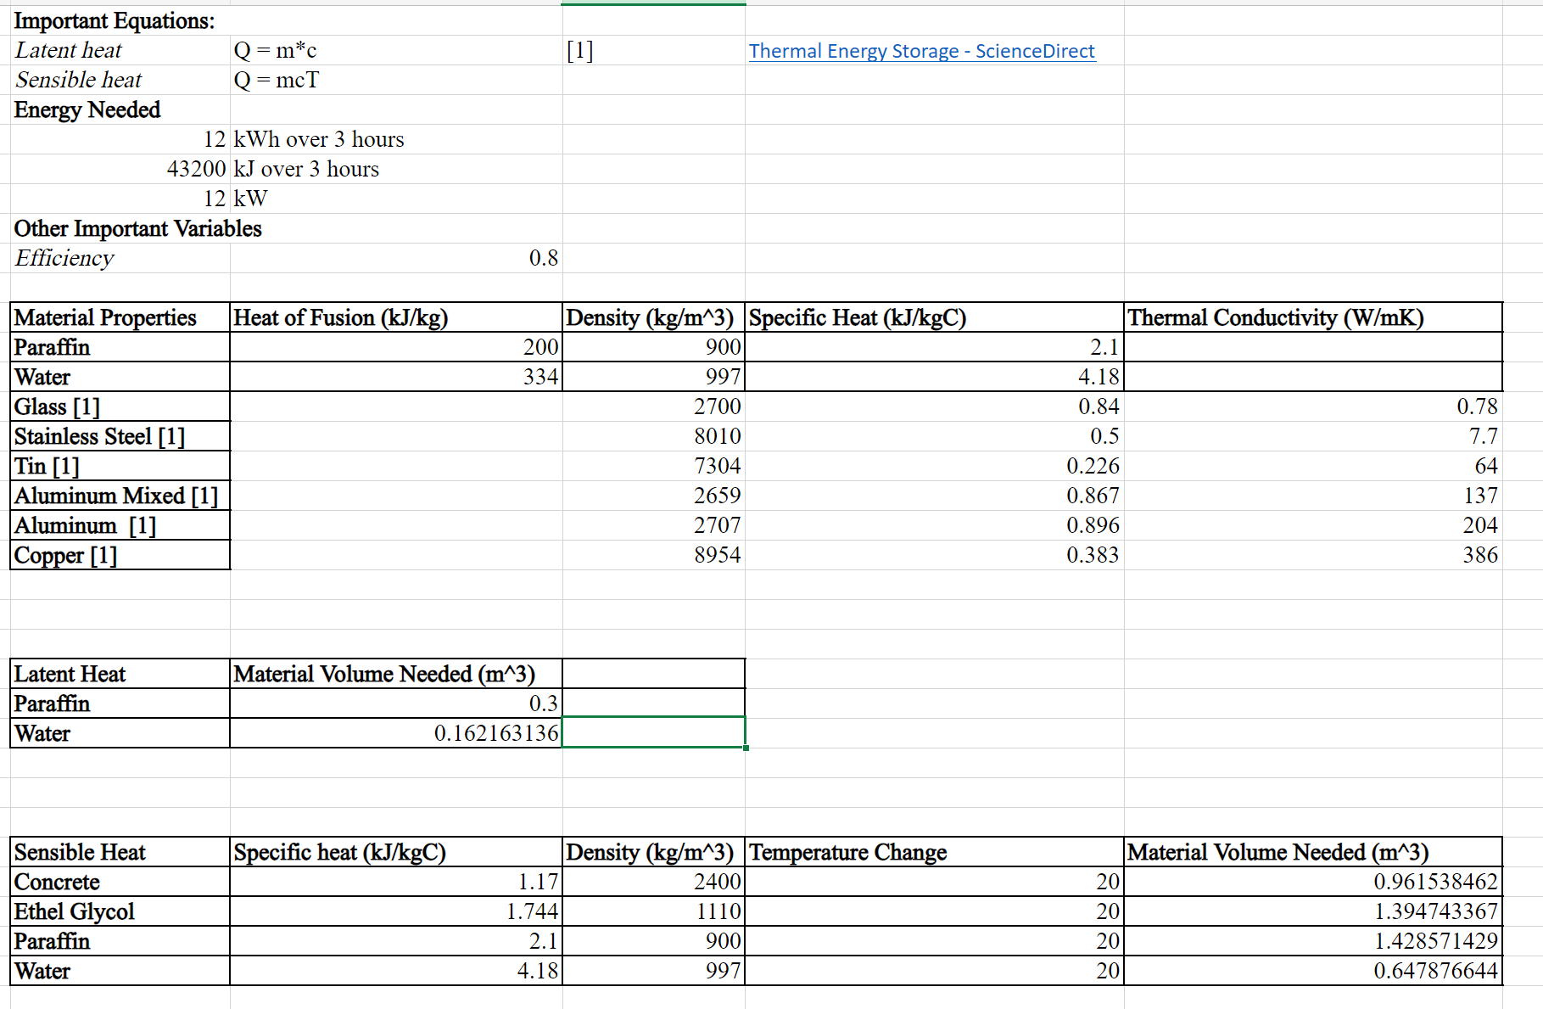
Material Analysis

Slide 5
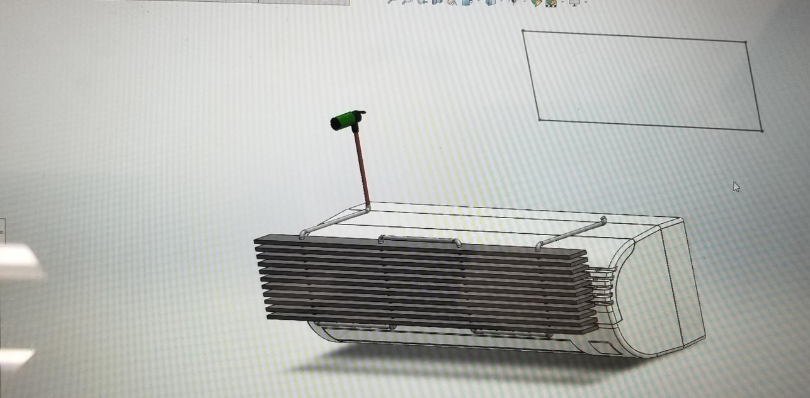
Model

Slide 6
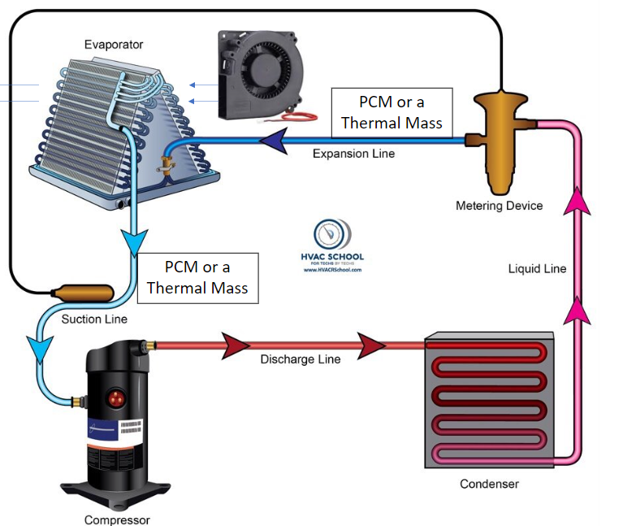
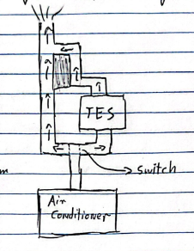
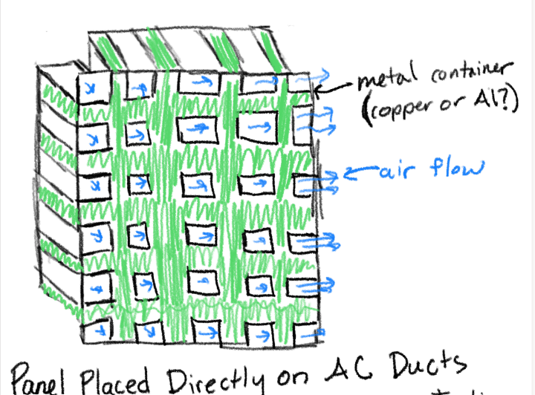

Slide 7

Questions-
Final Thoughts-
Overview
Analysis memo coming up

